Slide 1
Digital Circuit Experiment Flip-Flop
Lecture 4
Rencan Nie（聂仁灿）

Slide 2
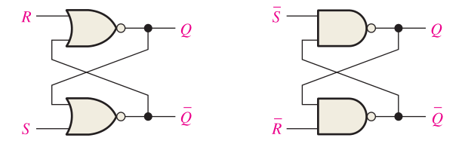

Theoretical Basis
Latch : S-R Latch
A latch is a type of bistable logic device or multivibrator. An active-HIGH input S-R (SET-RESET) latch is formed with two cross-coupled NOR gates; an active-LOW input S-R latch is formed with two cross-coupled NAND gates.
Notice that the output of each gate is connected to an input of the opposite gate. This produces the regenerative feedback that is characteristic of all latches and flip-flops.
Active-HIGH input S-R latch
Active-LOW input $\overline{S}$- $\overline{R}$ latch

Slide 3
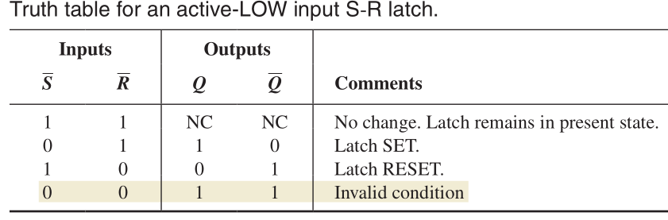
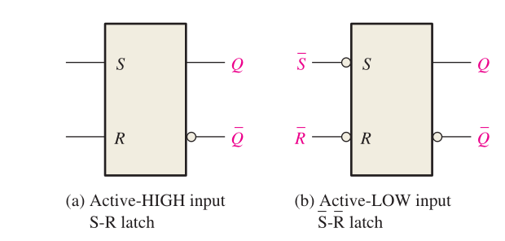
Theoretical Basis
Latch : S-R Latch

Slide 4
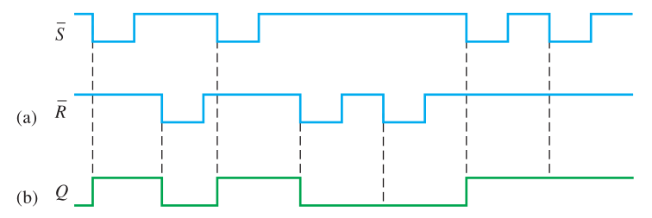
Theoretical Basis
Latch : S-R Latch
Following example illustrates how an active-LOW input S-R latch responds to conditions on its inputs. LOW levels are pulsed on each input in a certain sequence and the resulting Q output waveform is observed. The S = 0, R = 0 condition is avoided because it results in an invalid mode of operation and is a major drawback of any SET-RESET type of latch.

Slide 5
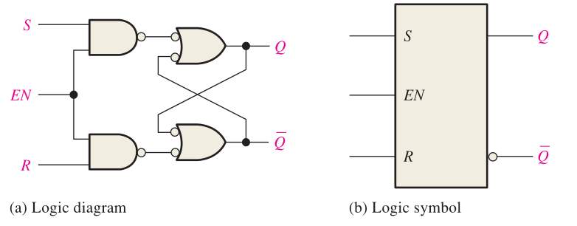
Theoretical Basis
Latch : LGated S-R Latch
A gated latch requires an enable input. The S and R inputs control the state to which the latch will go when a HIGH level is applied to the EN input. The latch will not change until EN is HIGH; but as long as it remains HIGH, the output is controlled by the state of the S and R inputs. The gated latch is a level-sensitive device. In this circuit, the invalid state occurs when both S and R are simultaneously HIGH and EN is also HIGH.

Slide 6
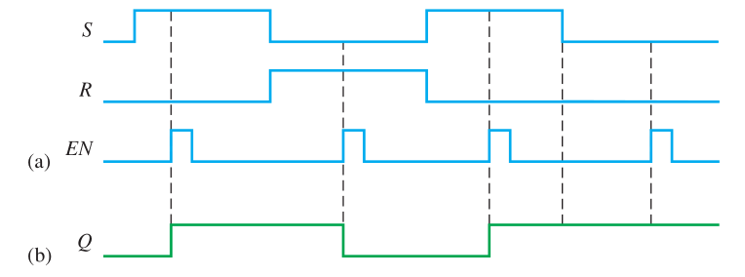
Theoretical Basis
Latch : Gated S-R Latch
Determine the Q output waveform if the inputs shown in following left Figure are applied to a gated S-R latch that is initially RESET.

Slide 7
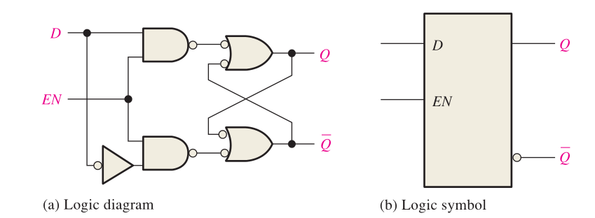
Theoretical Basis
Latch : Gated D Latch
Another type of gated latch is called the D latch. It differs from the S-R latch because it has only one input in addition to EN. This input is called the D (data) input. Following Figure contains a logic diagram and logic symbol of a D latch.
When the D input is HIGH and the EN input is HIGH, the latch will set. When the D input is LOW and EN is HIGH, the latch will reset. Stated another way, the output Q follows the input D when EN is HIGH.

Slide 8
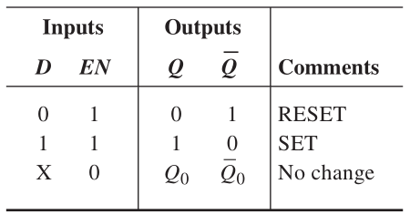
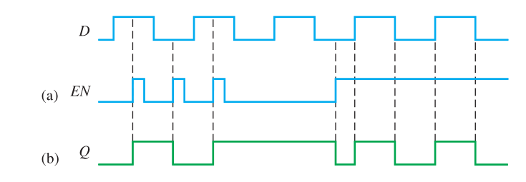
Theoretical Basis
Latch : Gated D Latch
Determine the Q output waveform if the inputs shown in following right Figure are applied to a gated D latch, which is initially RESET.
When D is HIGH and EN is HIGH, Q goes HIGH. When D is LOW and EN is HIGH, Q goes LOW. When EN is LOW, the state of the latch is not affected by the D input.

Slide 9
Theoretical Basis
Flip-Flops
Flip-flops are synchronous bistable devices, also known as bistable multivibrators. In this case, the term synchronous means that the output changes state only at a specified point (leading or trailing edge) on the triggering input called the clock (CLK), which is designated as a control input, C; that is, changes in the output occur in synchronization with the clock. Flip-flops are edge-triggered or edge-sensitive whereas gated latches are level-sensitive.

Slide 10
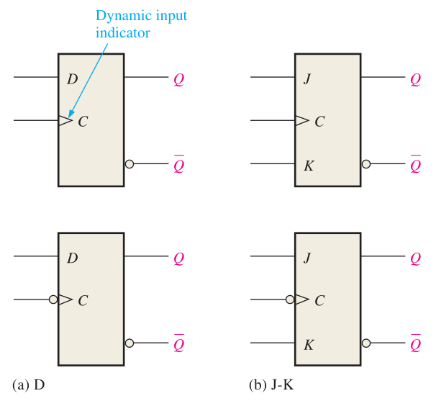
Theoretical Basis
Flip-Flops
An edge-triggered flip-flop changes state either at the positive edge (rising edge) or at the negative edge (falling edge) of the clock pulse and is sensitive to its inputs only at this transition of the clock.
positive edge-triggered
negative edge-triggered

Slide 11
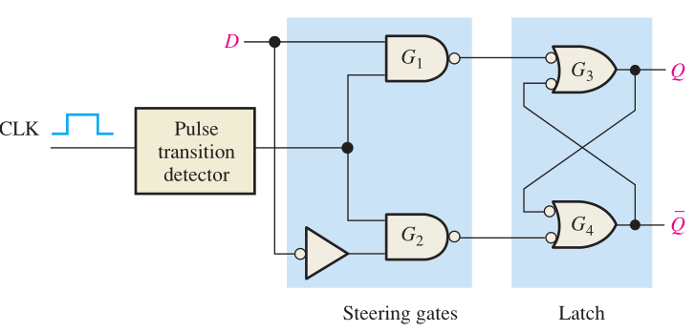
Theoretical Basis
Flip-Flops
D Flip-Flop
The D input of the D flip-flop is a synchronous input because data on the input are transferred to the flip-flop’s output only on the triggering edge of the clock pulse.
The basic D flip-flop differs from the gated D latch only in that it has a pulse transition detector

Slide 12
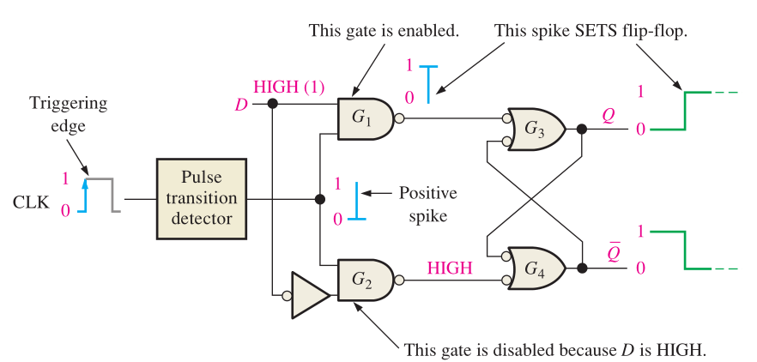
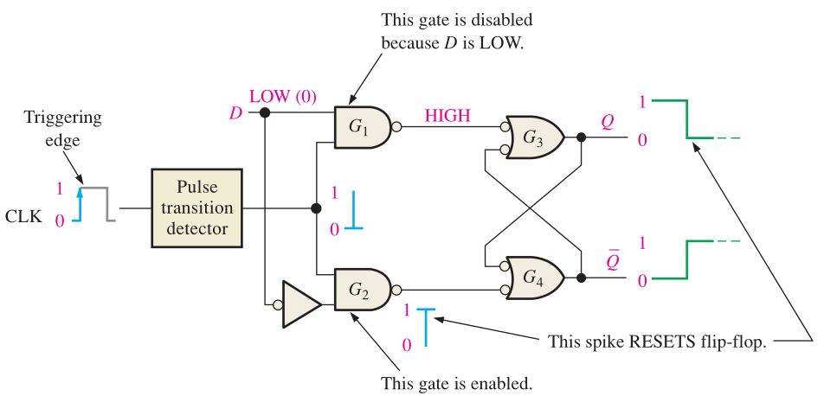
Theoretical Basis
Flip-Flops
D Flip-Flop
When D is HIGH, the Q output goes HIGH on the triggering edge of the clock pulse, and the flip-flop D flip-flop but D as variable. 396 Latches, Flip-Flops, and Timers is SET. When D is LOW, the Q output goes LOW on the triggering edge of the clock pulse, and the flip-flop is SET. When D is LOW, the Q output goes LOW on the triggering edge of the clock pulse, and the flip-flop is RESET.

Slide 13
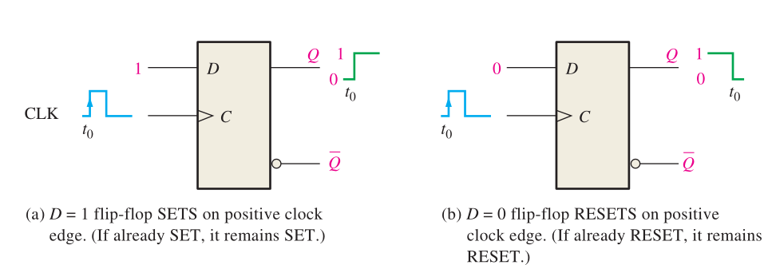
Theoretical Basis
Flip-Flops
D Flip-Flop
Remember, the flip-flop cannot change state except on the triggering edge of a clock pulse.

Slide 14
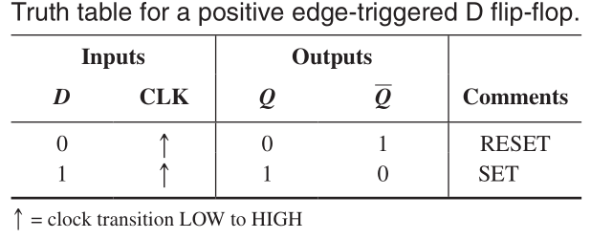
Theoretical Basis
Flip-Flops
D Flip-Flop
Remember, the flip-flop cannot change state except on the triggering edge of a clock pulse.
The operation and truth table for a negative edge-triggered D flip-flop are the same as those for a positive edge-triggered device except that the falling edge of the clock pulse is the triggering edge.

Slide 15
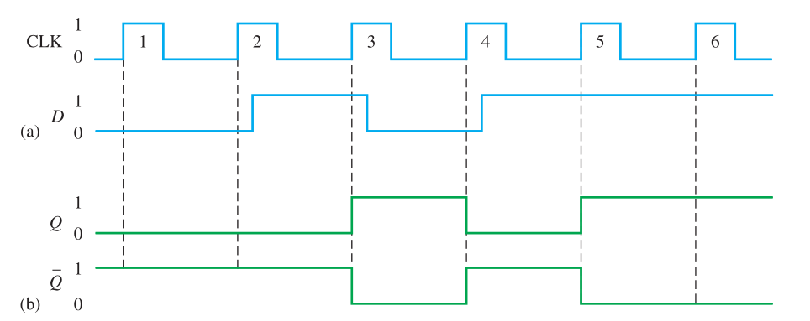
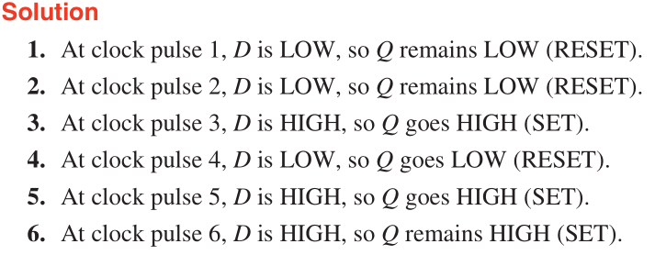
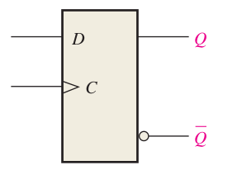
Theoretical Basis
Flip-Flops
D Flip-Flop

Slide 16
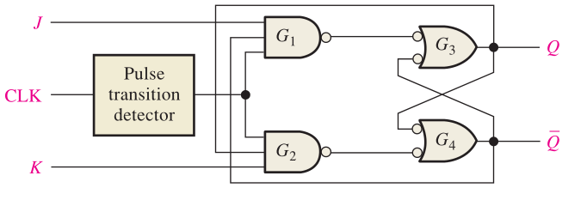
Theoretical Basis
Flip-Flops
J-K Flip-Flop
Following Figure shows the basic internal logic for a positive edge-triggered J-K flip-flop. The Q output is connected back to the input of gate G2 , and the Q output is connected back to the input of gate G1 . The two control inputs are labeled J and K in honor of Jack Kilby, who invented the integrated circuit. A J-K flip-flop can also be of the negative edge-triggered type, in which case the clock input is inverted.

Slide 17
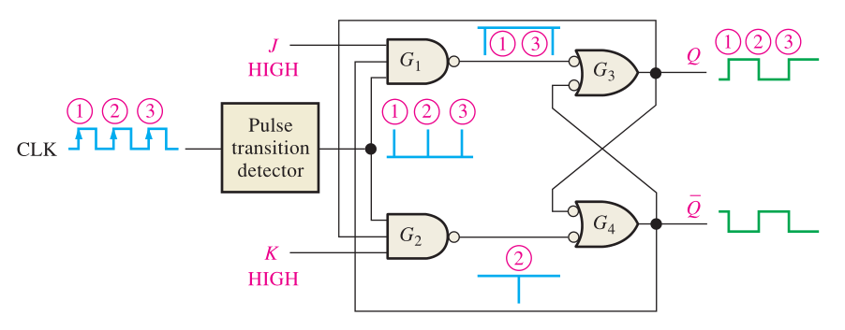
Theoretical Basis
Flip-Flops
J-K Flip-Flop
When a clock pulse occurs, a leading-edge spike indicated by ① is passed through gate G1 because Q is HIGH and J is HIGH. This will cause the latch portion of the flip-flop to change to the SET state. The flip-flop is now SET.

Slide 18
Theoretical Basis
Flip-Flops
J-K Flip-Flop
If you make J LOW and K HIGH, the next clock spike indicated by ② will pass through gate G 2 because Q is HIGH and K is HIGH. This will cause the latch portion of the flip-flop to change to the RESET state.

Slide 19
Theoretical Basis
Flip-Flops
J-K Flip-Flop
If you apply a LOW to both the J and K inputs, the flip-flop will stay in its present state when a clock pulse occurs. A LOW on both J and K results in a no-change condition.

Slide 20
Theoretical Basis
Flip-Flops
J-K Flip-Flop
When both the J and K inputs are HIGH and the flip-flop is RESET, the HIGH on the Q enables gate G 1 ; so the clock spike indicated by ③ passes through to set the flip-flop. Now there is a HIGH on Q, which allows the next clock spike to pass through gate G2 and reset the flip-flop.

Slide 21
Theoretical Basis
Flip-Flops
J-K Flip-Flop
As you can see, on each successive clock spike, the flip-flop toggles to the opposite state.

Slide 22
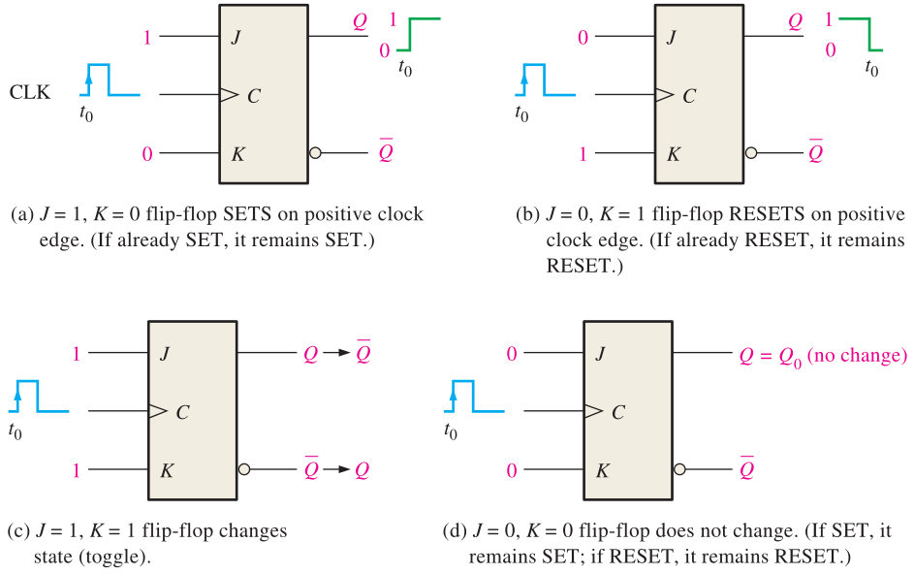
Theoretical Basis
Flip-Flops
J-K Flip-Flop

Slide 23
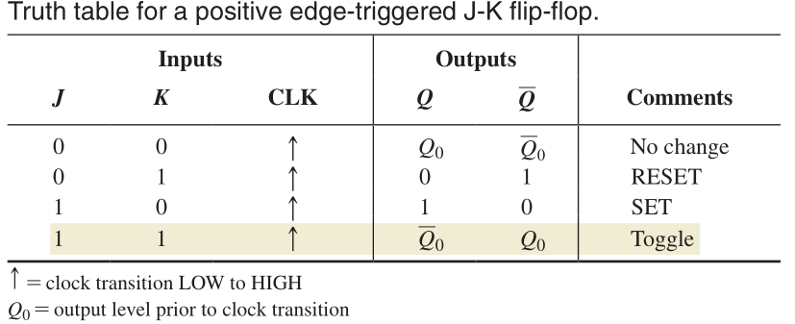
Theoretical Basis
Flip-Flops
J-K Flip-Flop

Slide 24
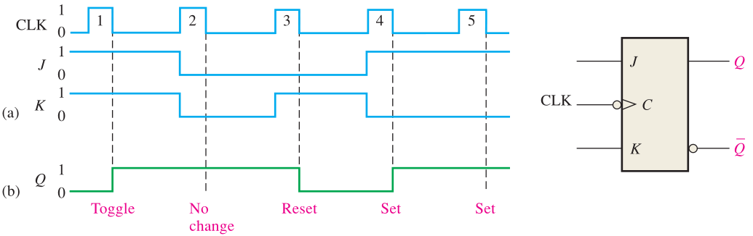
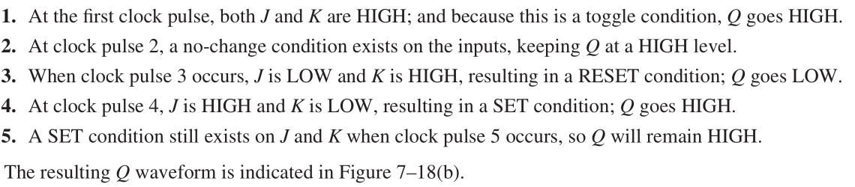
Theoretical Basis
Flip-Flops
J-K Flip-Flop

Slide 25
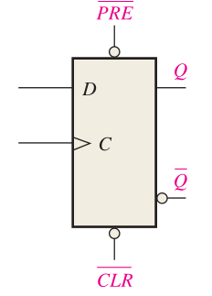
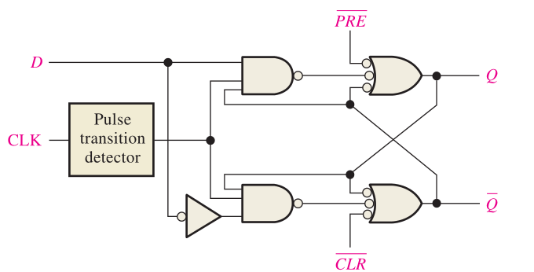
Theoretical Basis
Flip-Flops
Asynchronous Preset and Clear Inputs
Most integrated circuit flip-flops also have asynchronous inputs. These are inputs that affect the state of the flip-flop independent of the clock. They are normally labeled preset (PRE) and clear (CLR), or direct set (SD ) and direct reset (RD ) by some manufacturers. An active level on the preset input will set the flip-flop, and an active level on the clear input will reset it.

Slide 26
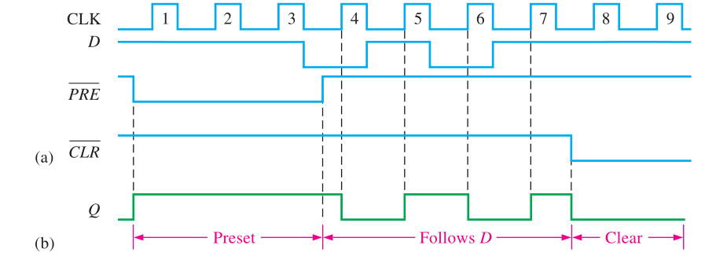
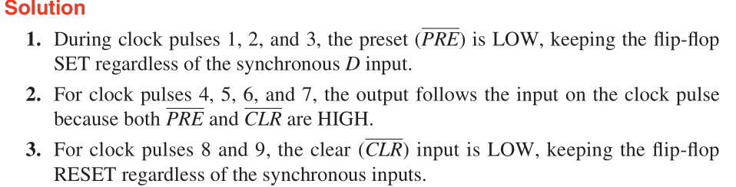
Theoretical Basis
Flip-Flops
Asynchronous Preset and Clear Inputs

Slide 27
Experiments
Experimental purposes
Test the function test for a S-R Latch.
Test the function test for a D-FF.
Test the function test for a JK-FF.

Slide 28
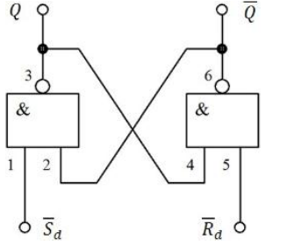
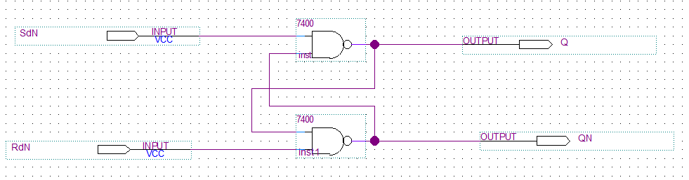
Experimental Contents
1. Function test for a S-R Latch
Task 1: Test the function for a S-R Latch.
Step 1: Design the circuit in Quartus 13.1

Slide 29
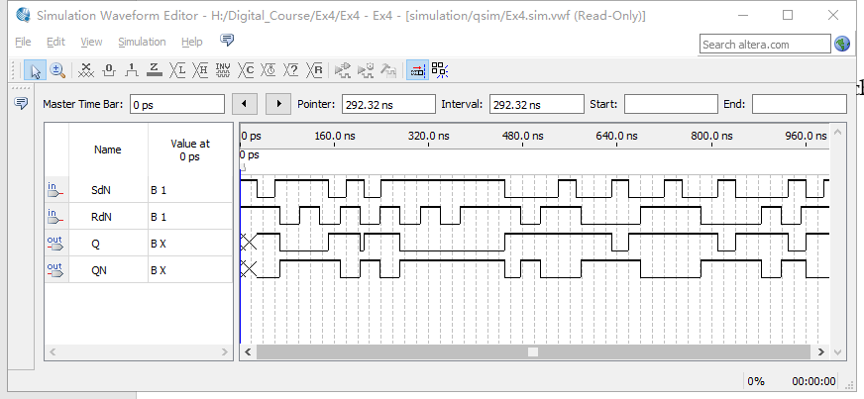
Experimental Contents
1. Function test for a S-R Latch
Task 1: Test the function for a S-R Latch.
Step 2: Step 2: Compile the designed file, and construct the VMF to watch the simulation results.

Slide 30
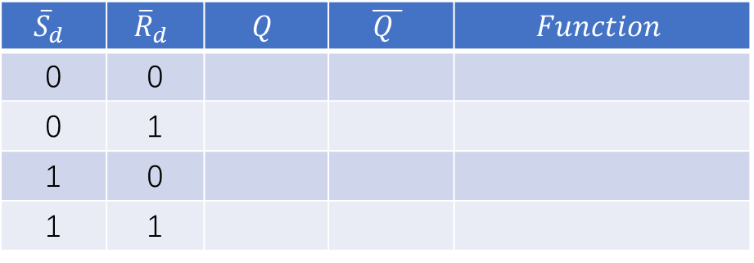
Experimental Contents
1. Function test for a S-R Latch
Task 1: Test the function for a S-R Latch.
Step 3: According to the simulation results, pls finish the contents of Table 1.
Table 1. The logical function table of a S-R latch
$${\overline{S}}_{d}$$ | $${\overline{R}}_{d}$$ | $$Q$$ | $$\overline{Q }$$ | $$Function$$
0 | 0
0 | 1
1 | 0
1 | 1

Slide 31
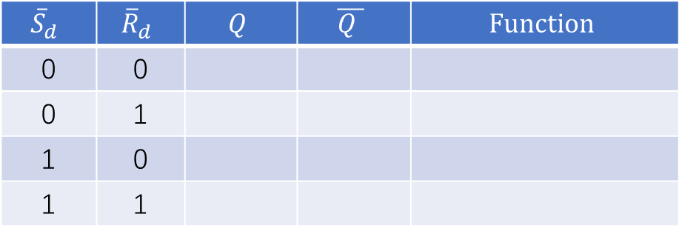
Experimental Contents
1. Function test for a S-R Latch
Task 1: Test the function for a S-R Latch.
Step 4: According to logical function table of a S-R latch, pls answer the questions as follows?
Table 1. The logical function table of a S-R latch
$${\overline{S}}_{d}$$ | $${\overline{R}}_{d}$$ | $$Q$$ | $$\overline{Q }$$ | $$Function$$
0 | 0
0 | 1
1 | 0
1 | 1
1. What are the main functions for a S-R latch?
2. How many valid states does a S-R latch have?
3. What is the invalid state for a S-R latch? It will result in a what constraint for the inputs of this latch.

Slide 32
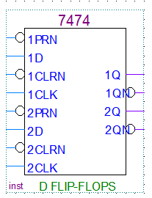
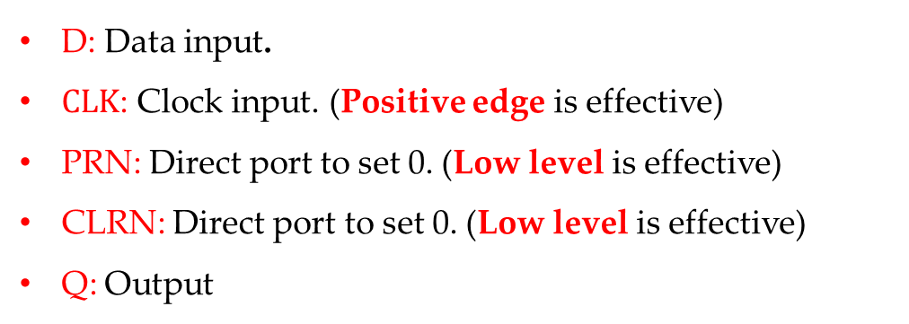
Experimental Contents
2. Function test for a D-FF
Task 1: Test the function for a D-FF with 74LS74.
74LS74 in Quartus.
There are two D-FF in a 74LS74 chip.
D: Data input.
$CLK$: Clock input. (Positive edge is effective)
PRN: Direct port to set 0. (Low level is effective)
CLRN: Direct port to set 0. (Low level is effective)
Q: Output

Slide 33
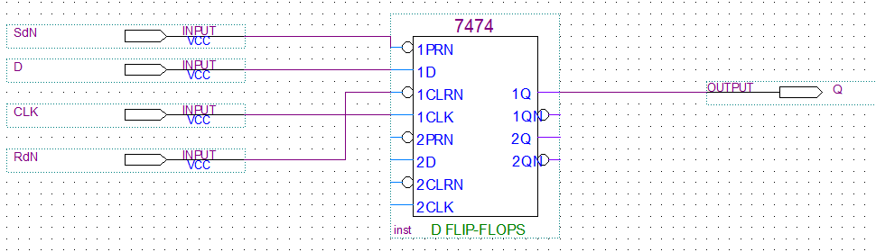
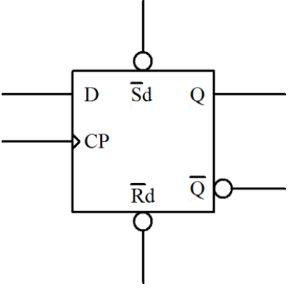
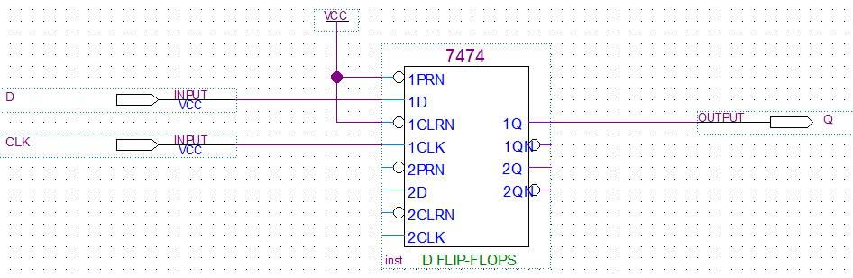


Experimental Contents
2. Function test for a D-FF
Task 1: Test the function for a D-FF with 74LS74.
Step 1: Design the circuit in Quartus 13.1
${\overline{S}}_{d}$=0, ${\overline{R}}_{d}$ = 1 or ${\overline{S}}_{d}$=1, ${\overline{R}}_{d}$ = 0
(a)
${\overline{S}}_{d}$=1, ${\overline{R}}_{d}$ = 1
(b)

Slide 34
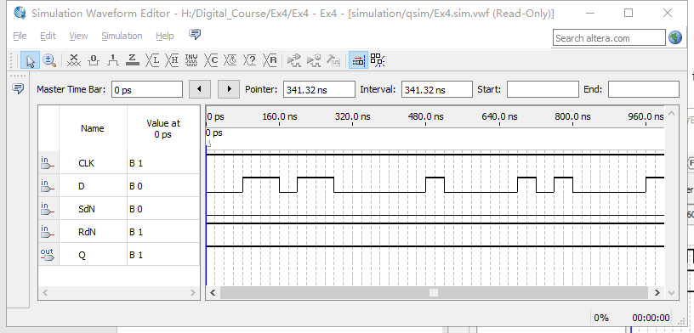

Experimental Contents
2. Function test for a D-FF
Task 1: Test the function for a D-FF with 74LS74.
Step 3: Compile the designed file, and construct the VMF to watch the simulation results for different inputs.
Example: ${\overline{S}}_{d}$=0, ${\overline{R}}_{d}$ = 1

Slide 35
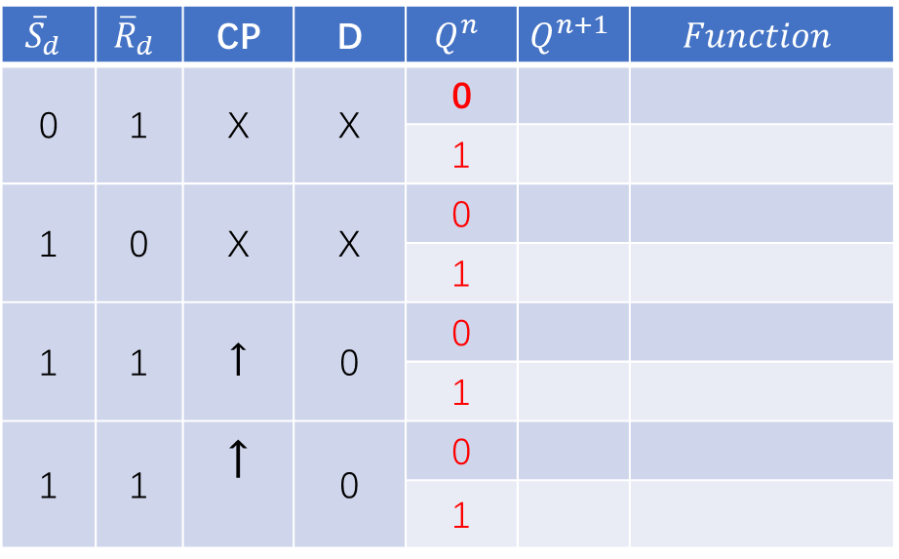
Experimental Contents
2. Function test for a D-FF
Task 1: Test the function for a D-FF with 74LS74.
Step 4: According to the simulation results, pls finish the contents of Table 2.
Table 2. The logical function table of a D-FF
$${\overline{S}}_{d}$$ | $${\overline{R}}_{d}$$ | CP | D | $$Q^{n}$$ | $$Q^{n+1}$$ | $$Function$$
0 | 1 | X | X | 0
0 | 1 |  |  | 1
1 | 0 | X | X | 0
1 | 1 |  |  | 1
1 | 1 | ↑ | 0 | 0
 |  |  |  | 1
1 | 1 | ↑ | 0 | 0
 |  |  |  | 1
Summary the functions for the D-FF

Slide 36
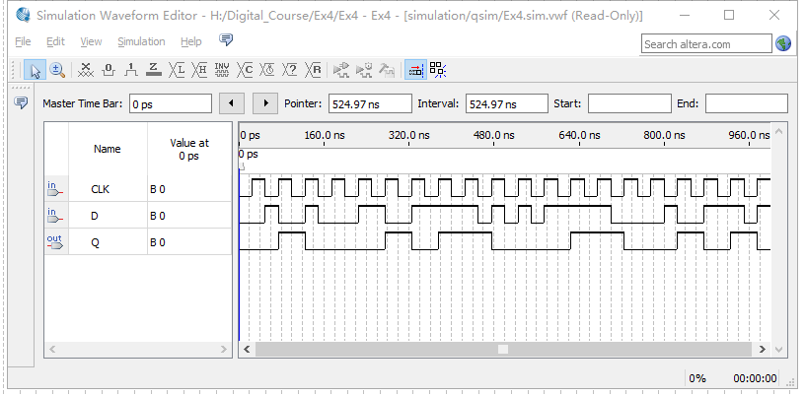
Experimental Contents
2. Function test for a D-FF
Task 1: Test the function for a D-FF with 74LS74.
Step 4: Input a continuous CP pulse in the VMF to watch the simulation.

Slide 37
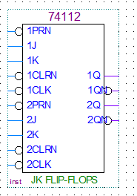
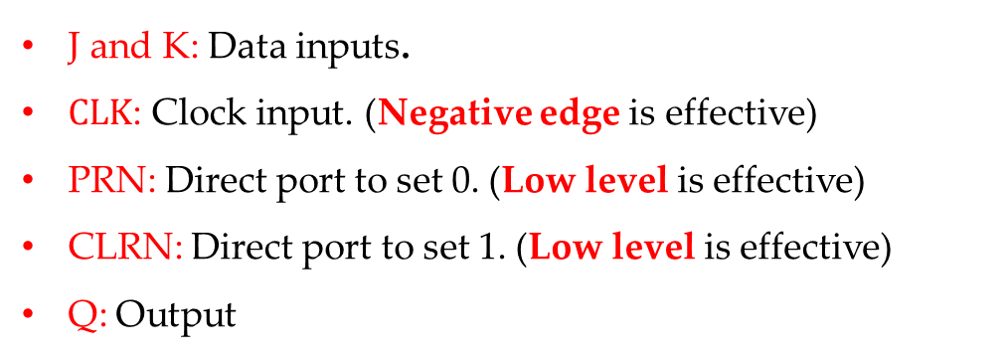
Experimental Contents
3. Function test for a JK-FF
Task 1: Test the function for a JK-FF with 74LS112.
74LS74 in Quartus.
There are two JK-FF in a 74LS112 chip.
J and K: Data inputs.
$CLK$: Clock input. (Negative edge is effective)
PRN: Direct port to set 0. (Low level is effective)
CLRN: Direct port to set 1. (Low level is effective)
Q: Output

Slide 38
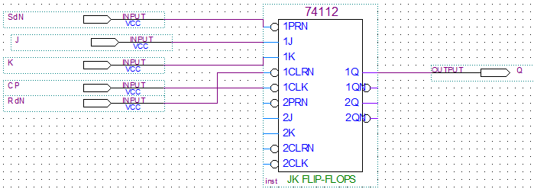
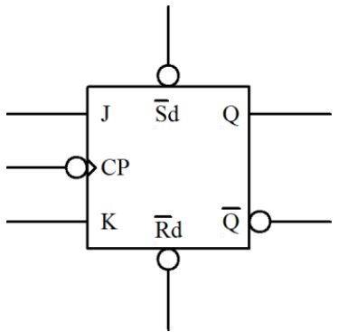
Experimental Contents
3. Function test for a JK-FF
Task 1: Test the function for a JK-FF with 74LS112.
Step 1: Design the circuit in Quartus 13.1
${\overline{S}}_{d}$=0, ${\overline{R}}_{d}$ = 1 or ${\overline{S}}_{d}$=1, ${\overline{R}}_{d}$ = 0
(a)
${\overline{S}}_{d}$=1, ${\overline{R}}_{d}$ = 1
(b)

Slide 39
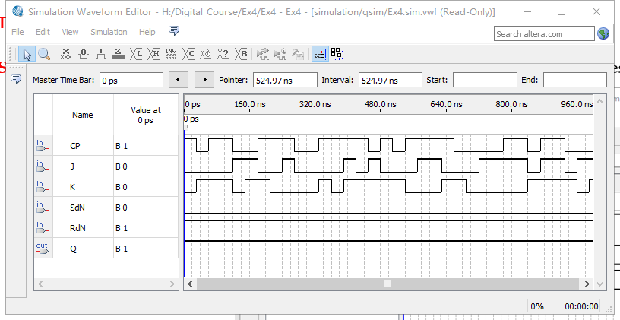
Experimental Contents
3. Function test for a JK-FF
Task 1: Test the function for a JK-FF with 74LS112.
Step 3: Compile the designed file, and construct the VMF to watch the simulation results for different inputs.
Example: ${\overline{S}}_{d}$=0, ${\overline{R}}_{d}$ = 1

Slide 40
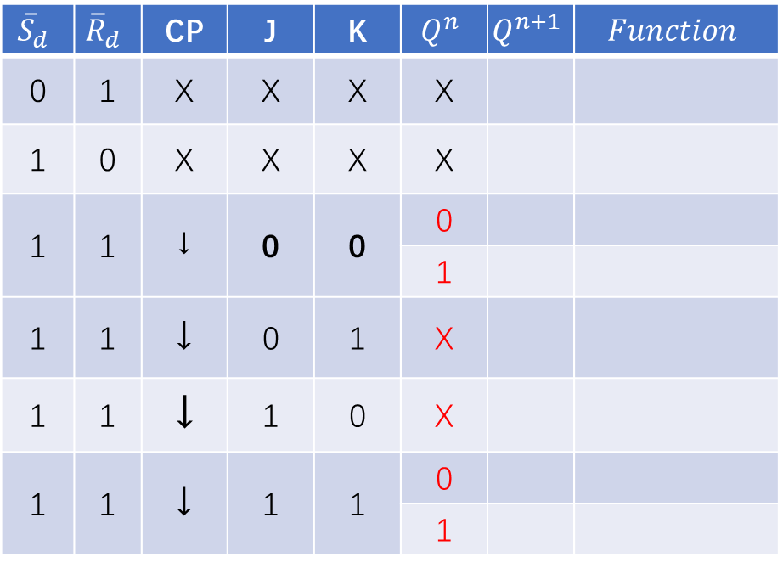
Experimental Contents
3. Function test for a JK-FF
Task 1: Test the function for a JK-FF with 74LS112.
Step 4: According to the simulation results, pls finish the contents of Table 2.
Table 3. The logical function table of a JK-FF
$${\overline{S}}_{d}$$ | $${\overline{R}}_{d}$$ | CP | J | K | $$Q^{n}$$ | $$Q^{n+1}$$ | $$Function$$
0 | 1 | X | X | X | X
1 | 0 | X | X | X | X
1 | 1 | ↓ | 0 | 0 | 0
1 | 1 |  |  |  | 1
1 | 1 | ↓ | 0 | 1 | X
1 | 1 | ↓ | 1 | 0 | X
1 | 1 | ↓ | 1 | 1 | 0
 |  |  |  |  | 1
Summary the functions for the JK-FF

Slide 41
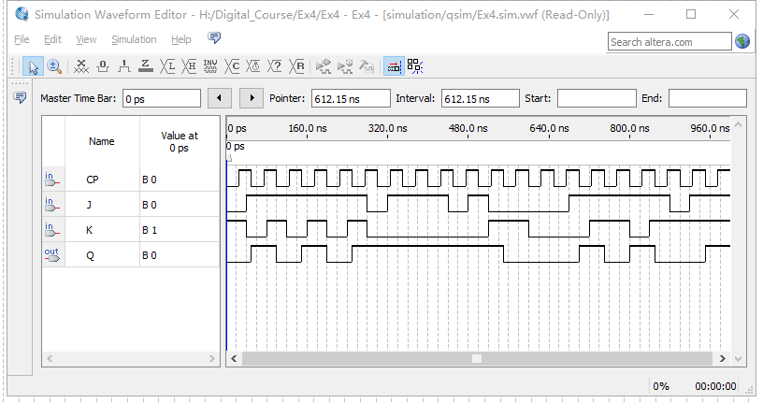
Experimental Contents
3. Function test for a JK-FF
Task 1: Test the function for a JK-FF with 74LS112.
Step 4: Input a continuous CP pulse in the VMF to watch the simulation.

Slide 42
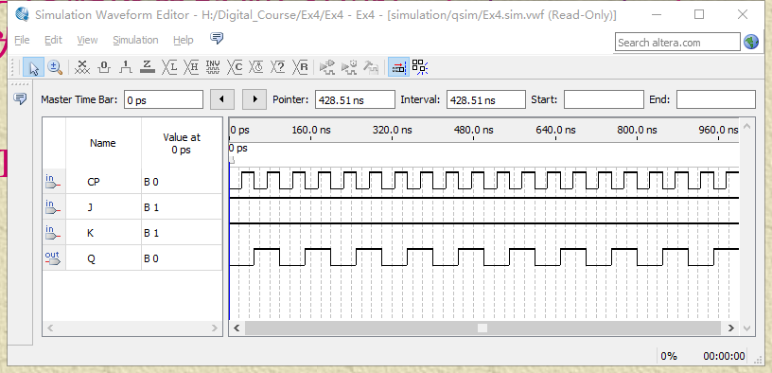

Experimental Contents
3. Function test for a JK-FF
Task 1: Test the function for a JK-FF with 74LS112.
Step 5: Input a continuous CP pulse in the VMF to watch the simulation when J=K=1.
T’-FF
$$Q^{n+1}=\overline{Q^{n}}$$

Slide 43
Thanks

